Slide 1
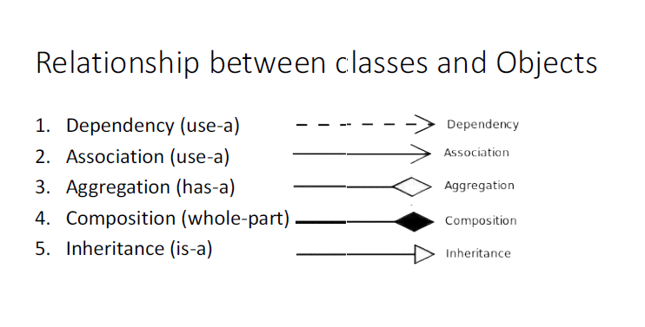

Slide 2
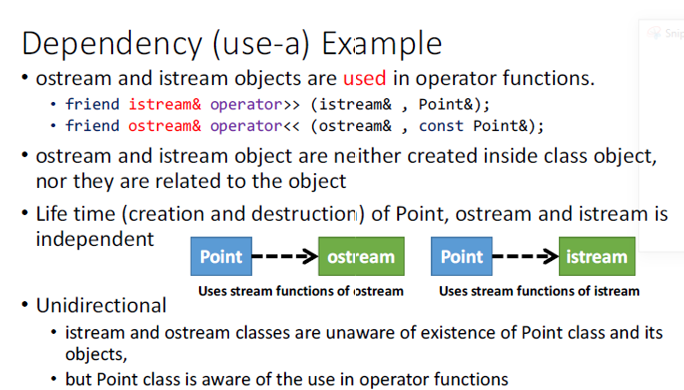

Slide 3
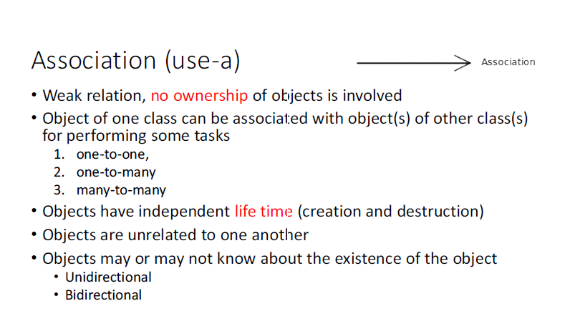

Slide 4
Association
Kinds of Association: There are two main types of association which are then further subdivided i.e
1. Class Association
2. Object Association

Slide 5
Association
Class Association
Class association is implemented in terms of Inheritance. Inheritance implements generalization/specialization relationship between objects. Inheritance is considered class association.
In case of public inheritance it is “IS-A” relationship.

Slide 6
Association
Object Association
It is the interaction of stand alone objects of one class with other objects of anther class.
It can be of one of the following types,
Composition
Aggregation

Slide 7
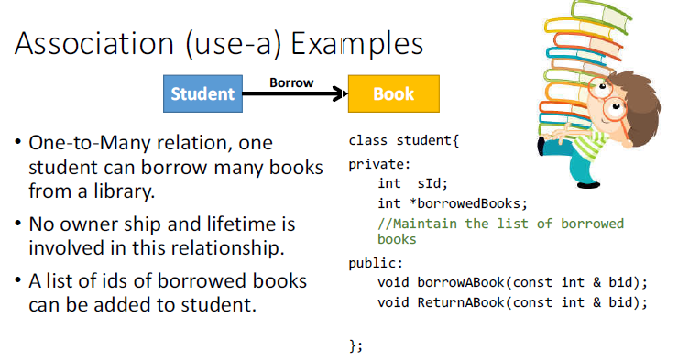

Slide 8
Simple Association
The two interacting objects have no intrinsic relationship with other object. It is the weakest link between objects. It is a reference by which one object can interact with some other object.
Customer gets cash from cashier
Employee works for a company
Ali lives in a house
Ali drives a car

Slide 9
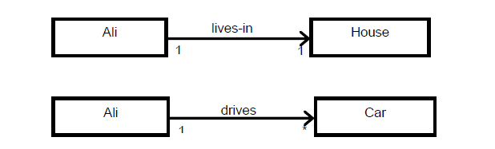
Simple Association
Simple association can be categorized in two ways,
• With respect to direction (navigation)
• With respect to number of objects (cardinality)
Kinds of Simple Association w.r.t Navigation
With respect to navigation association has the following types,
a. One-way Association
b. Two-way Association
a. One-way Association
In One way association we can navigate along a single direction only, it is denoted
by an arrow towards the server object.
Examples:

Slide 10
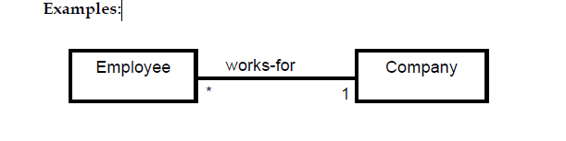
Simple Association
Two-way Association
In two way association we can navigate in both directions, it is denoted by a line
between the associated objects
Examples:
Employee works for company
Company employs employees
For example Managers and Employees, multiple employees may be associated with a single manager and a single employee may be associated with multiple managers.

Slide 11
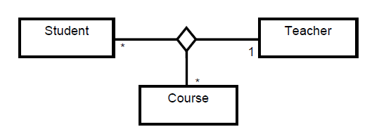
Kinds of Simple Association w.r.t Cardinality
With respect to cardinality association has the following types,
a. Binary Association
b. Ternary Association
c. N-ary Association
Binary Association
It associates objects of exactly two classes; it is denoted by a line, or an arrow between the associated objects.
Ternary Association
It associates objects of exactly three classes; it is denoted by a diamond with lines connected to associated objects.

Slide 12
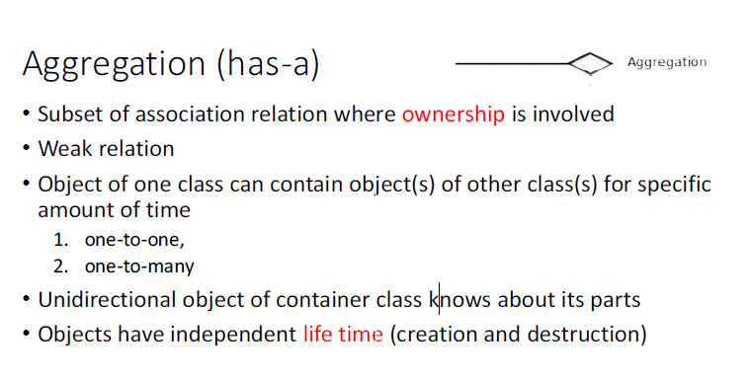

Slide 13
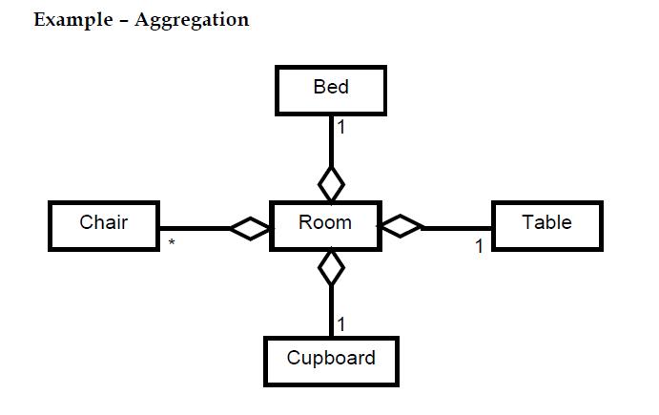
Aggregation
An object may contain a collection (aggregate) of other objects, the relationship between the container and the contained object is called aggregation, Aggregation is represented by a line with unfilled-diamond head towards the container
We can say it is a direct association among the objects. In Aggregation, the direction specifies which object contains the other object. There are mutual dependencies among objects.
For example, departments and employees, a department has many employees but a single employee is not associated with multiple departments. Employees may exist without a department. Here, department can be called an owner object and the employee can be called a child object.

Slide 14
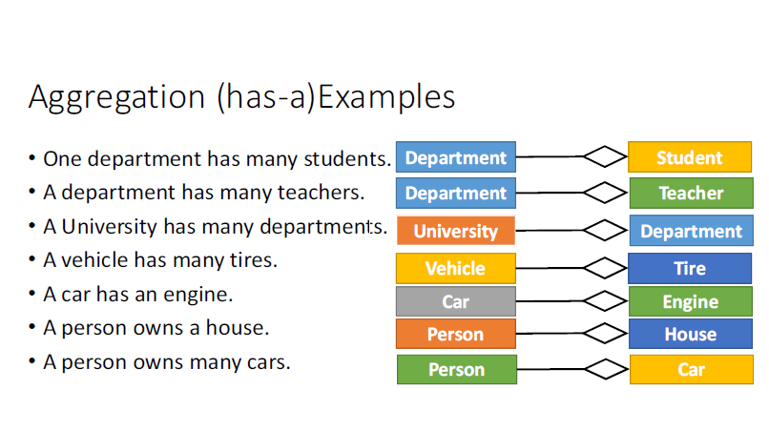

Slide 15
class B{
int b;
public:
B(int b=0){ this->b=b;}
};
class A{
int a;
B * objB; //pointer
public:
A(int a=0){ this->a=a;}
void addB(B *b){ this->objB = b;}
void removeB(){ objB = nullptr;}
Void changeB(B*b){ objB= b;}
~A(){ objB=nullptr;}
//nothing to do with objB
};
Use a pointer to aggregate class
object(s).
A B
void main(){
A a(1), a2;
B b, b2(3);
a.addB(&b);
a.changeB(&b2);
a2.addB(&b);
}

Slide 16
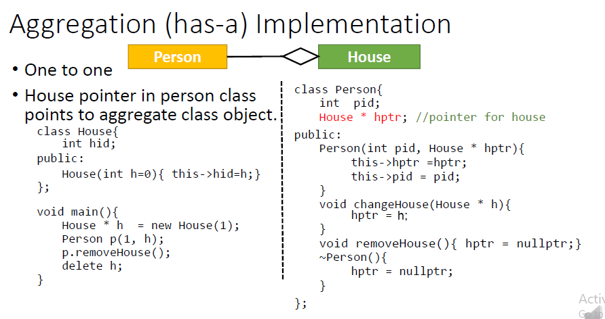
Aggregation

Slide 17
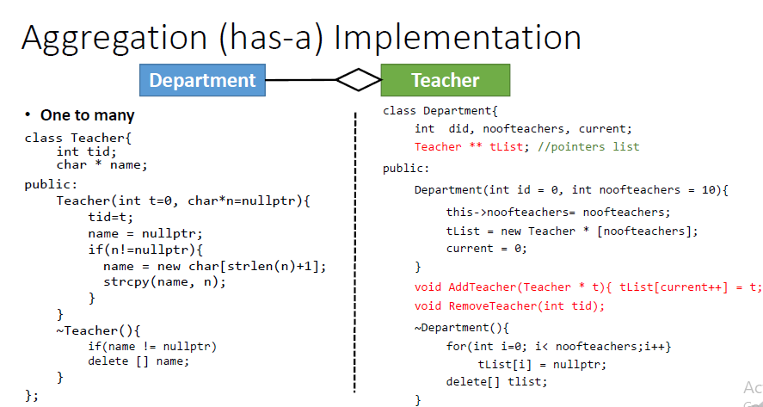
Aggregation

Slide 18
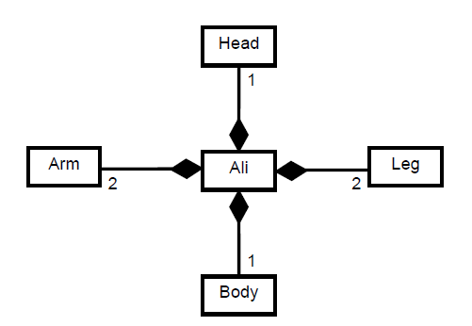
Composition
An object may be composed of other smaller objects, the relationship between the “part” objects and the “whole” object is known as Composition. Composition is represented by a line with a filled-diamond head towards the composer object
Example – Composition of Ali

Slide 19
Composition
Composition is stronger relationship:
Composition is a stronger relationship, because
Composed object becomes a part of the composer
Composed object can’t exist independently

Slide 20
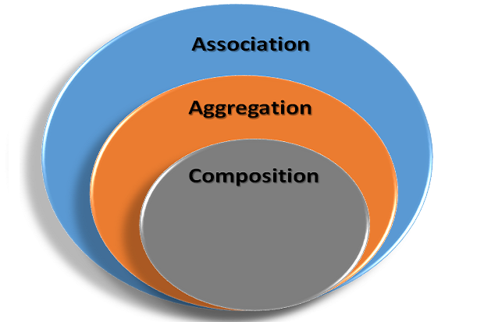

Slide 21

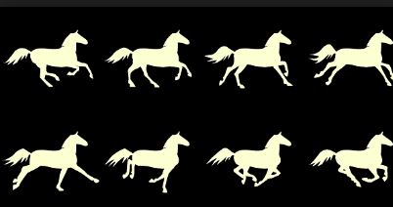
Composition: The following picture is image composition i.e. using individual images making one image.
collection of image in single location

Slide 22
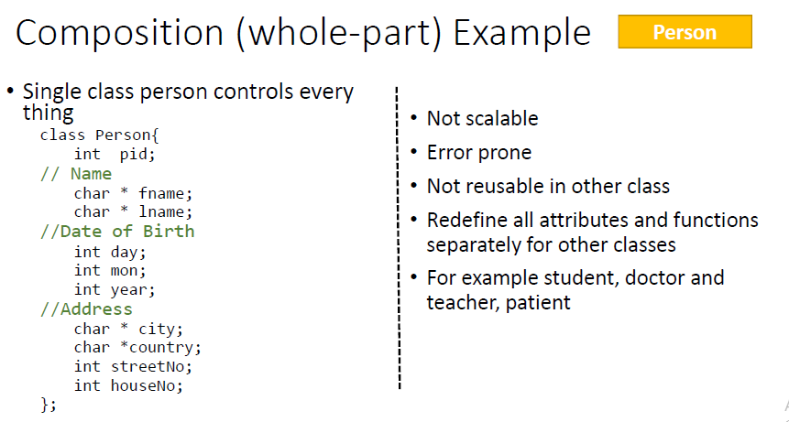

Slide 23
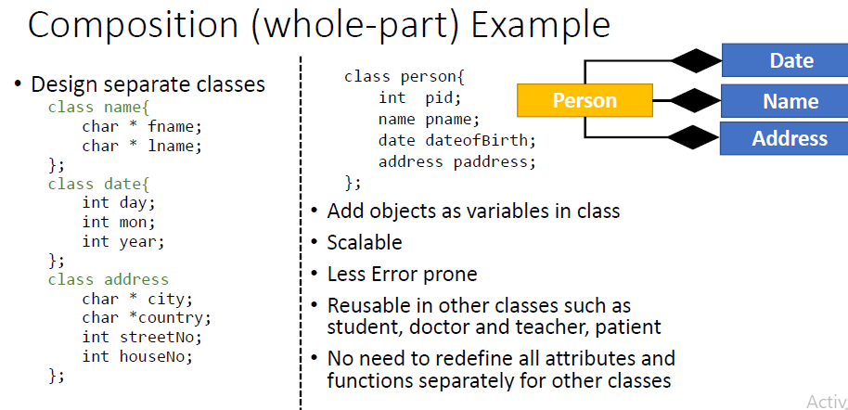

Slide 24
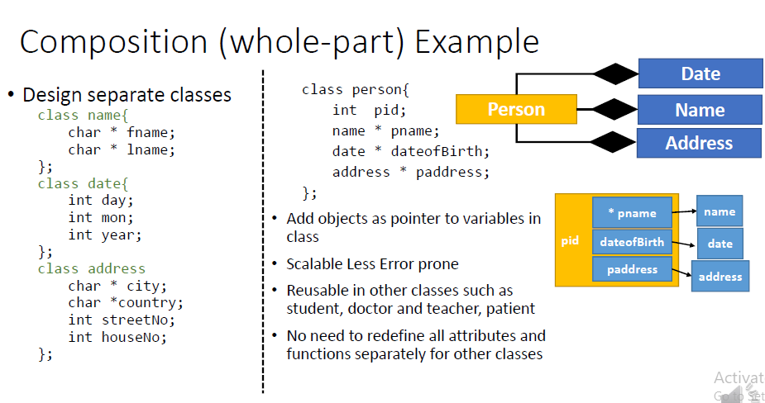

Slide 25
